Slide 1
Statistics Data Summary
Taegan Irving

Slide 2
Executive Summary
This report summarizes trends in construction costs, employees, contracts, and lumber prices across time. It highlights seasonal patterns by month and long-run changes by year using descriptive statistics and supporting charts.

Slide 3

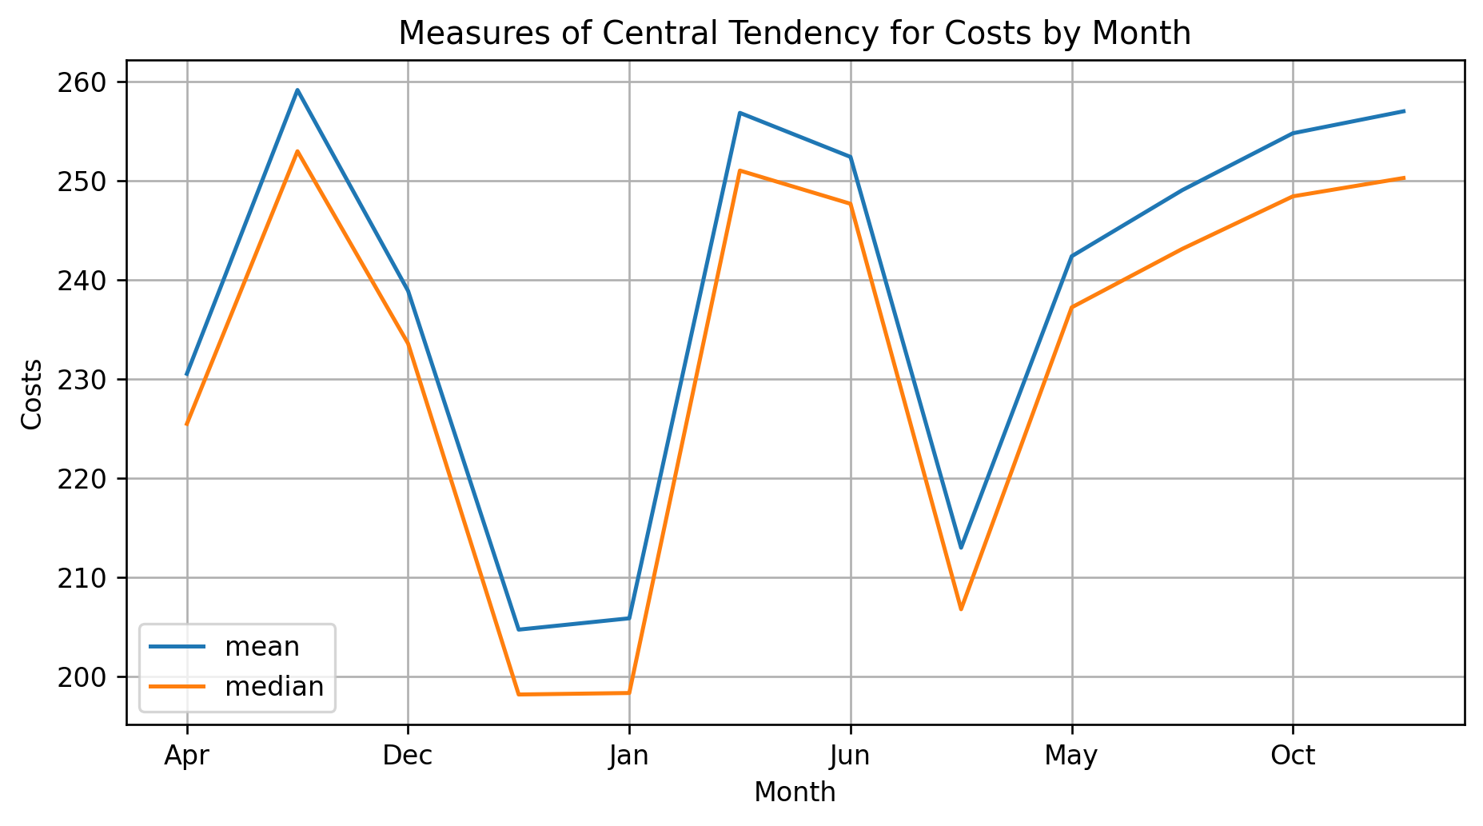
Costs by Month
This chart compares the mean and median monthly costs to show seasonal patterns in spending. Costs are lowest in the winter months, especially January and February, and rise through the spring and summer, peaking in late summer and early fall.
The mean is consistently slightly higher than the median, indicating that occasional higher-cost periods increase the average. Overall, the chart highlights clear seasonality, with higher costs during periods of increased construction activity and lower costs during the winter slowdown.

Slide 4
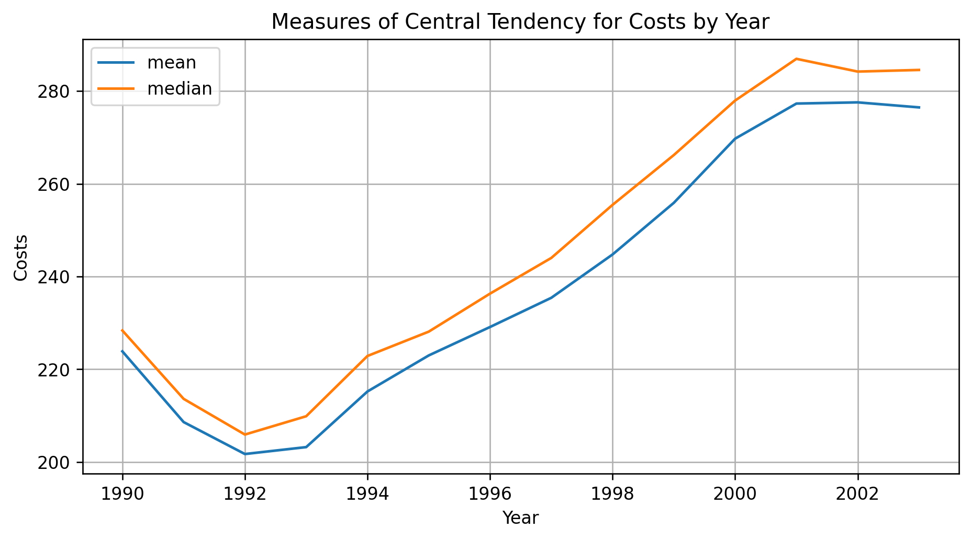
Costs by Year
This chart shows how average (mean) and typical (median) costs change over time from 1990 to 2003. Costs decline slightly in the early 1990s, reaching a low point around 1992–1993, and then increase steadily through the late 1990s and early 2000s.
The median is consistently above the mean, which suggests that a few lower-cost years pull the average down. After the mid-1990s, both measures rise together, indicating sustained growth rather than short-term volatility. Overall, the chart highlights a long-term upward trend in costs, likely driven by increasing activity and rising input prices over time.

Slide 5
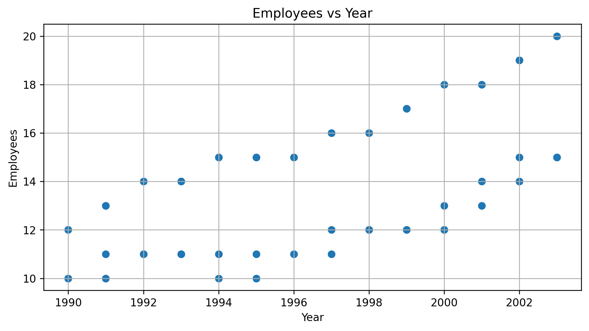
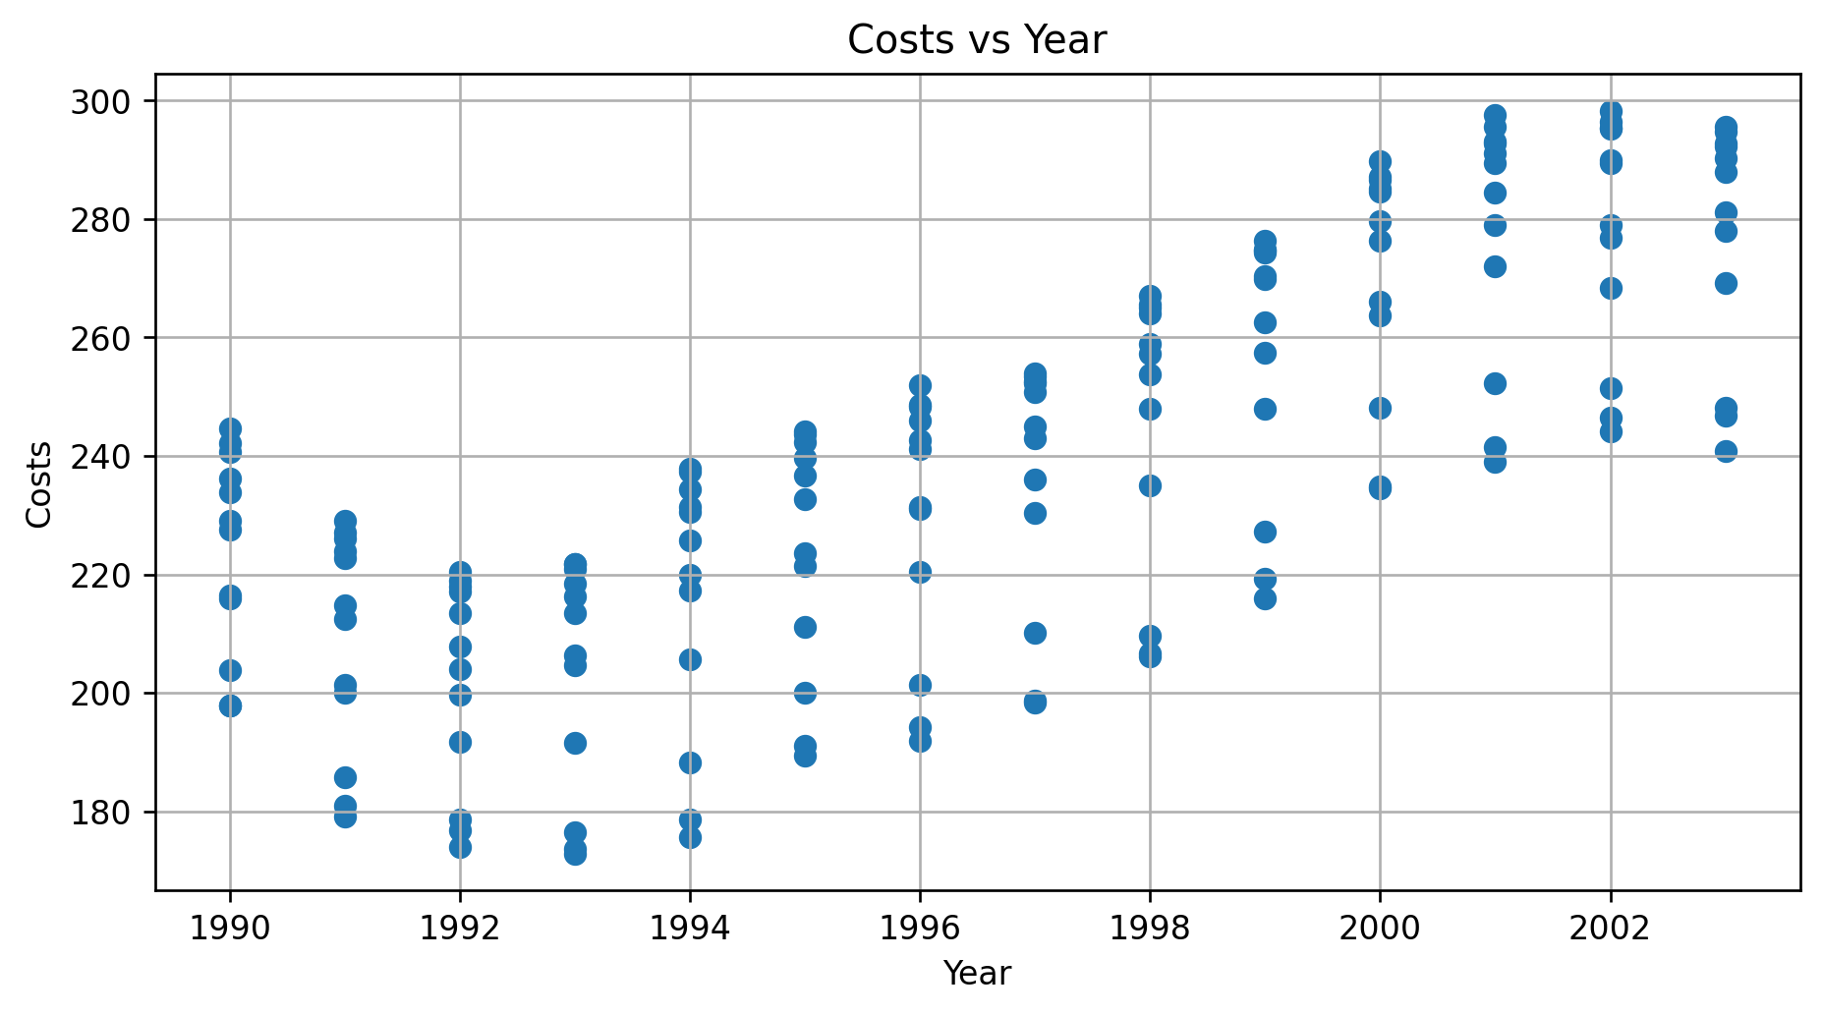
Growth in Employees and Costs Over Time
The upward trend in employee counts indicates deliberate workforce expansion to support growing operations. Early years show limited variation, suggesting a stable labor structure, while later years exhibit higher levels and more dispersion, implying scaling, role specialization, and increased capacity. This suggests that labor growth is a structural response to sustained increases in demand rather than short-term hiring.
The strong upward trend in costs reflects long-term growth in operational scale rather than random fluctuations. The increasing spread in later years indicates rising variability in expenses, likely driven by larger projects, higher material prices, and expanded staffing. With employee growth, the cost trend shows that expenses are closely tied to expansion and rising input costs, reinforcing the interpretation of sustained business growth.

Slide 6
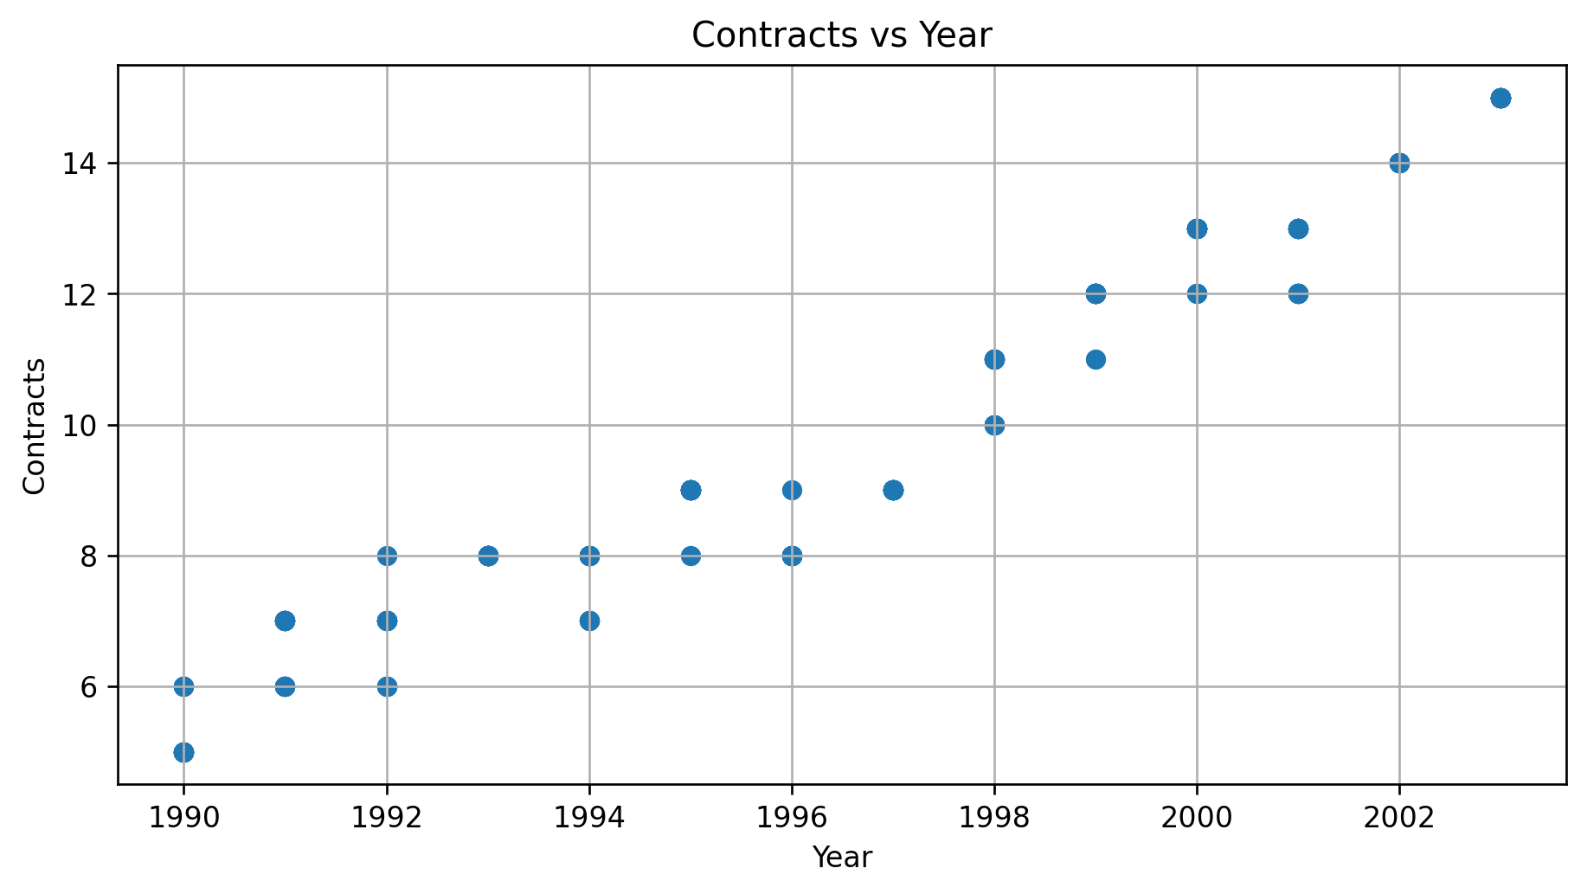
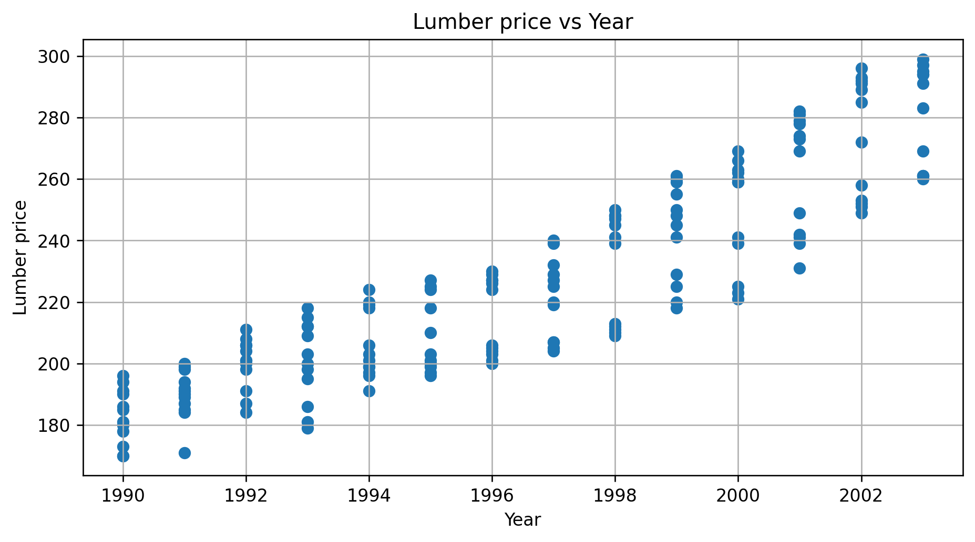
Rising Demand and Increasing Input Cost Pressure
The steady increase in contracts over time indicates sustained growth in demand rather than short-term fluctuations. The relatively tight clustering in early years suggests stable but limited activity, while the higher and more spread-out values in later years imply both expansion and increasing variability in project volume. This pattern is consistent with a firm scaling operations and taking on a broader mix of projects as capacity grows.
The upward trend in lumber prices reflects rising input costs over the period, driven by increased demand and broader market pressures. The growing dispersion in later years suggests heightened price volatility, which can increase cost uncertainty for projects. This explains rising overall costs and highlights material prices as a key driver of financial risk and expense growth over time.

Slide 7
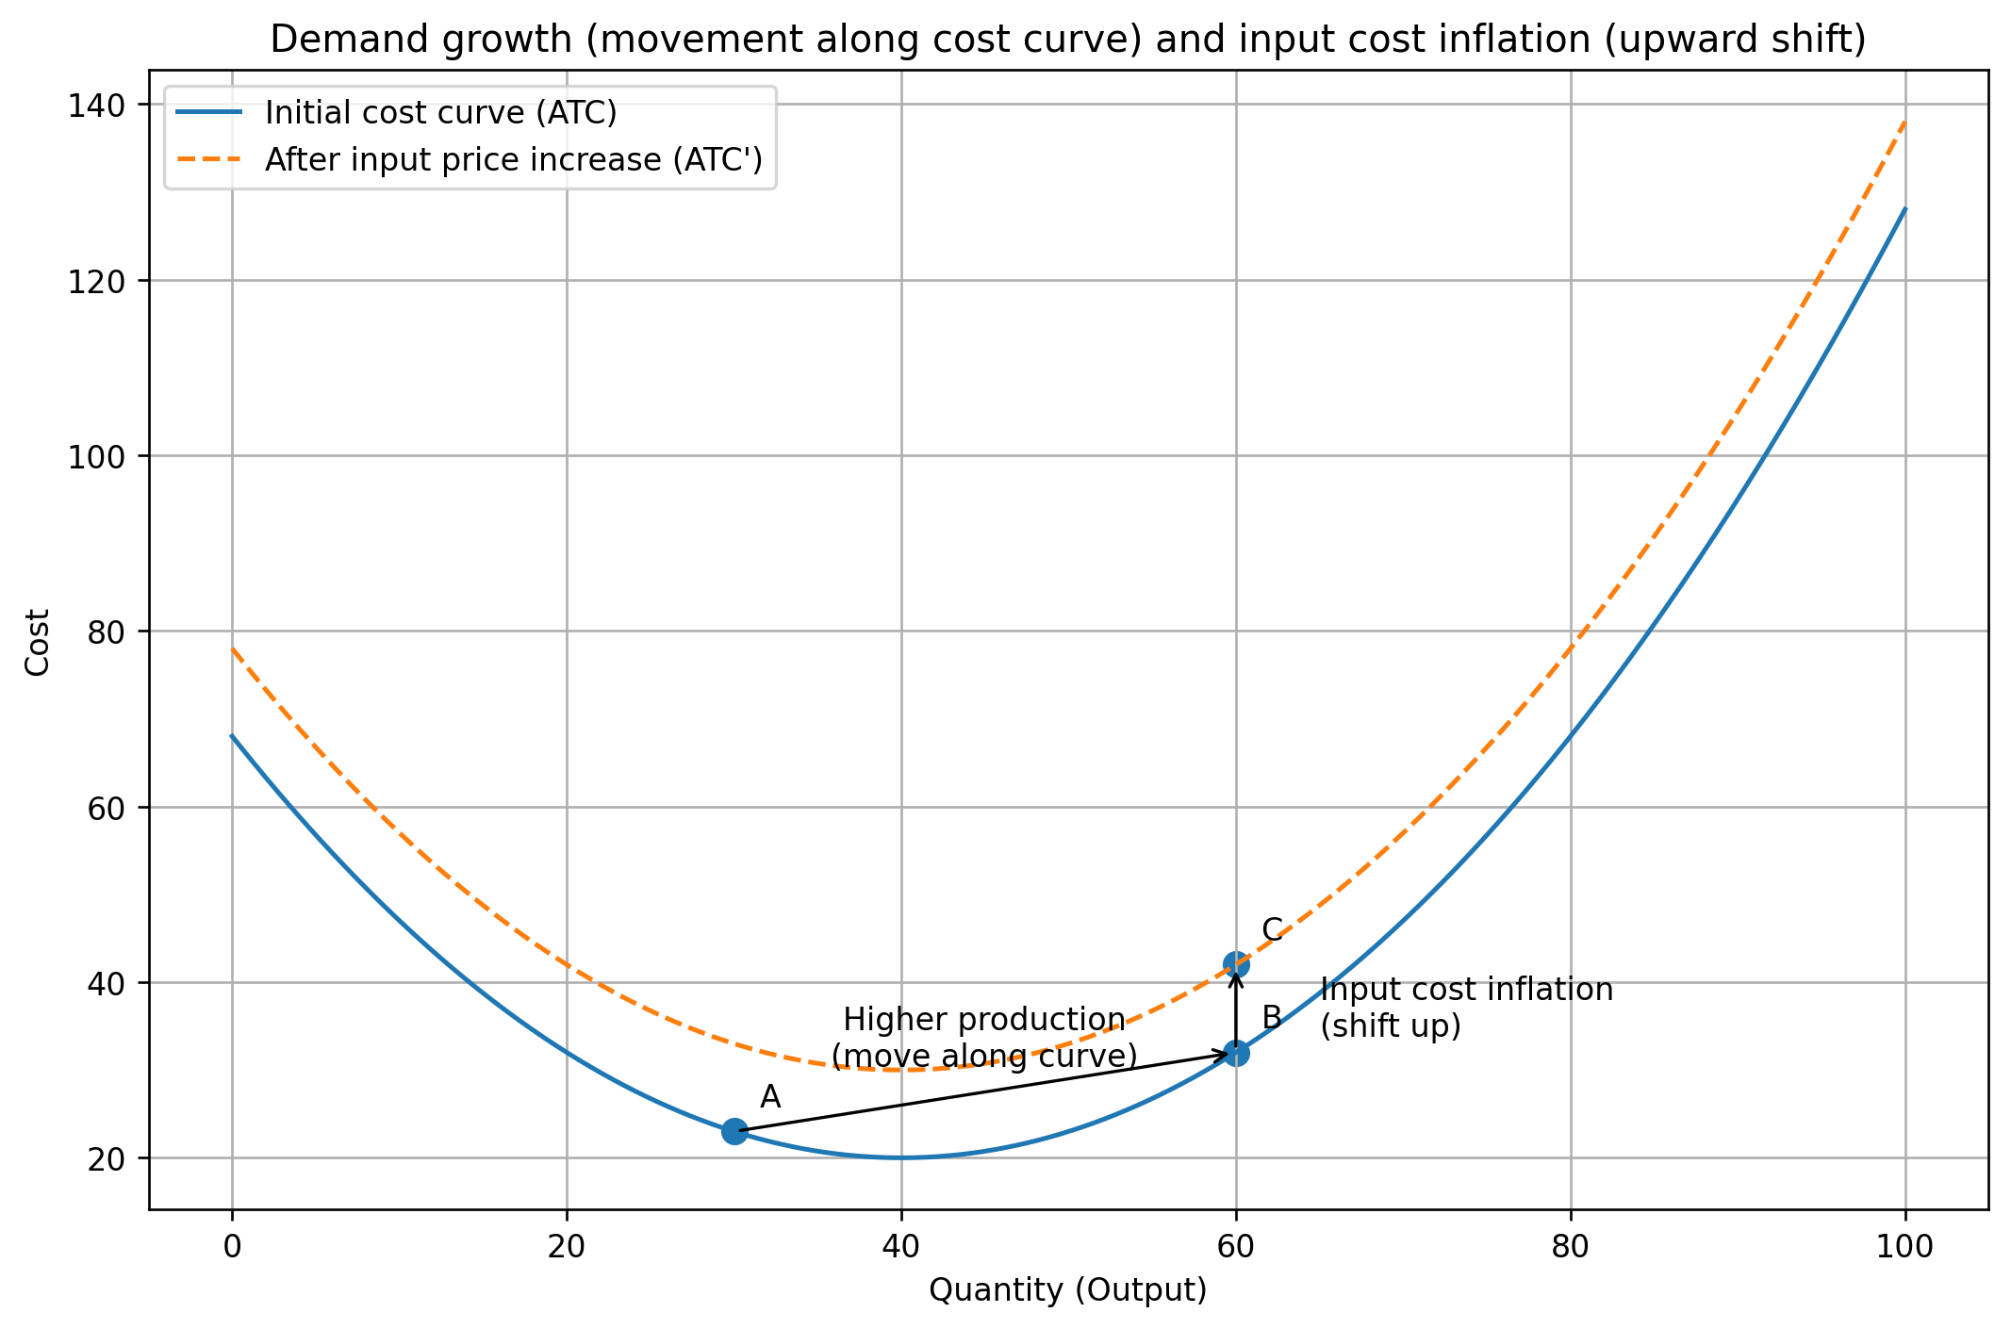
Final Economic Takeaway
The data shows sustained demand growth, reflected in rising contracts and workforce expansion. As output increases, firms hire more labor to expand capacity, which raises operating costs. At the same time, rising lumber prices increase input costs, pushing total expenses higher.
Economically, this reflects both movement along the cost curve from higher production and an upward shift in costs from input price inflation. Overall, growth in demand combined with rising input prices explains the long-run increase in costs and variability over time.

